Slide 1
Does A Medical Consortium Influence Health Outcomes of Hospitalized Cancer Patients?
An Integrated Care Model in Shanxi, China
Miao Cai, M.S.

Slide 2
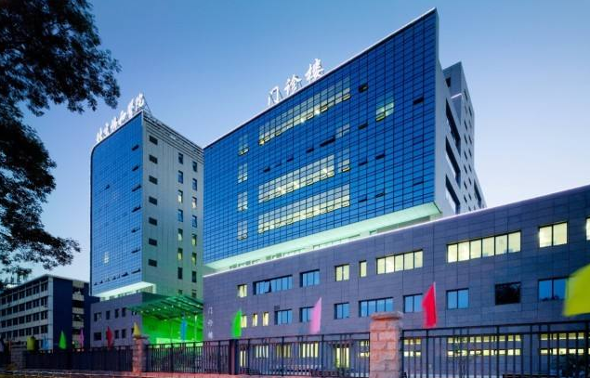


Hospital system in China
Tertiary
Secondary
Primary

Slide 3
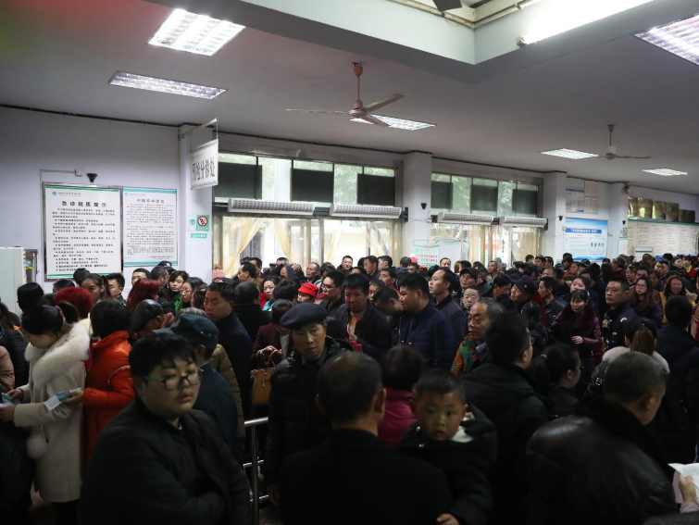
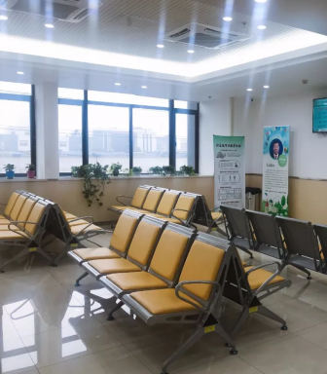

Slide 4
Medical consortium
Vertical Integration
A Tertiary Hospital
Secondary hospitals
Secondary hospitals
……
Primary hospitals……
Community health centers……

Slide 5
Research question
?
Medical consortium
Patients’ outcomes

Slide 6




Study sample
n = 8,193
Cancer
Secondary hospitals
Treatment & Control
n = 2,803
n = 8,193

Slide 7


Treatment
Mortality rates
30%
…
10%
Control

Slide 8





Treatment
Sweetness
Control

Slide 9
Treatment group
Control group
Shanxi Provincial Cancer Hospital
Secondary hospitals
Secondary hospitals
Other secondary hospitals
Propensity score
matching
…
…

Slide 10





Propensity score
matching
Treatment
Sweetness
Control

Slide 11
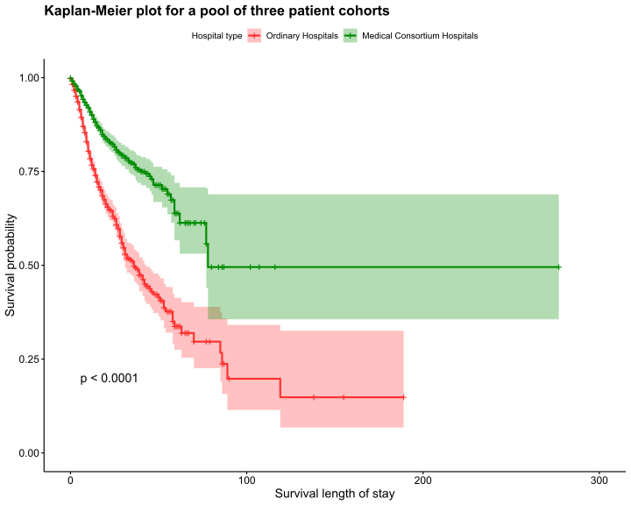
Kaplan-Meier
survival curves

Slide 12
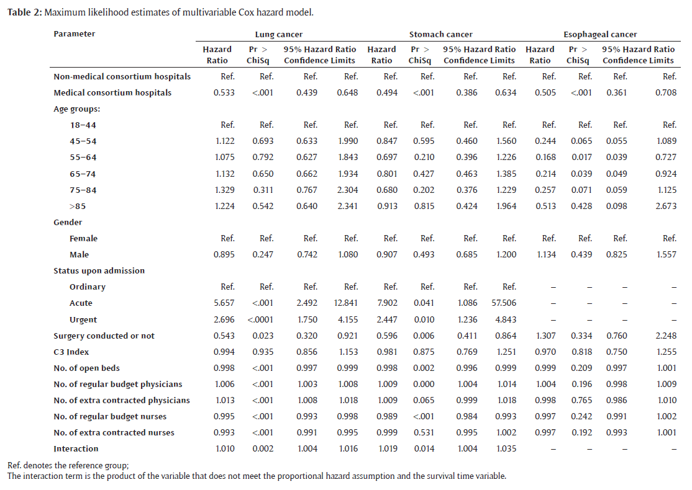
0.533 (0.439 - 0.648) 0.494 (0.386 - 0.634) 0.505 (0.361 – 0.708)

Slide 13



What did they do?
Expert team
Further education
Two-way referral

Slide 14
Concerns
Payments? incentives?
Tertiary hospitals expanding their territories?
Medical consortium → Monopoly?

Slide 15
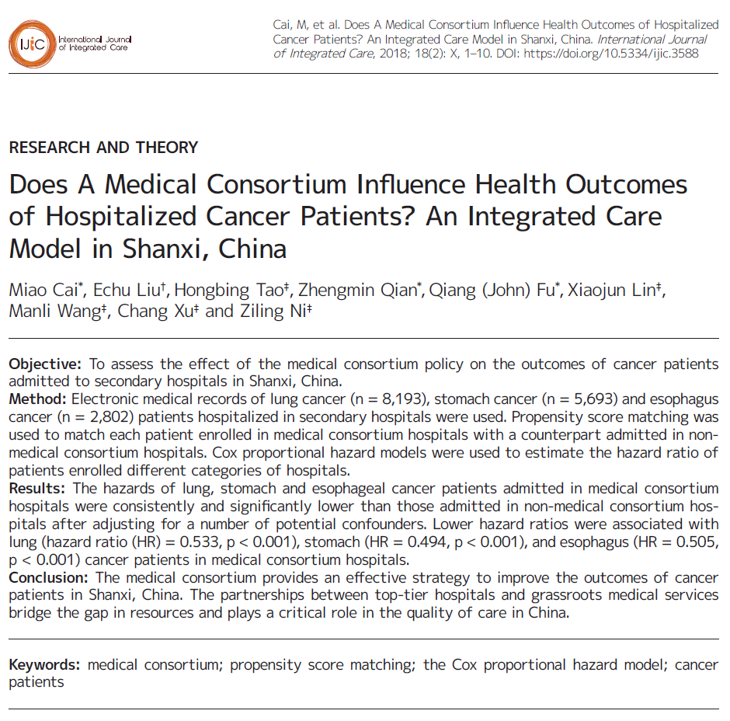
Reference
Cai, M., Liu, E., Tao, H., Qian, Z., Fu, Q. J., Lin, X., ... & Ni, Z. (2018). Does A Medical Consortium Influence Health Outcomes of Hospitalized Cancer Patients? An Integrated Care Model in Shanxi, China. International Journal of Integrated Care, 18:7. DOI: http://doi.org/10.5334/ijic.3588

Slide 16
Q & A

